Slide 1
Tutorial
on 3D Slicer python scripting and programming

Slide 2
Agenda
Part 1
Software architecture
Part 2
Use python console in Slicer
Simple scripted module example
Part 3
Write simple scripted module individually

Slide 3
Slicer application architecture
Slicer application core
Extensions
MRML scene
Module X
Module A
Module Y
Module B
…
…
Module Z
Module N
Libraries (Qt, VTK, ITK, CTK, Python, numpy,…)
Notes:
Questions to attendees:
Who has Linux / C++ / python / Slicer / VTK / ITK / Qt experience?

Slide 4
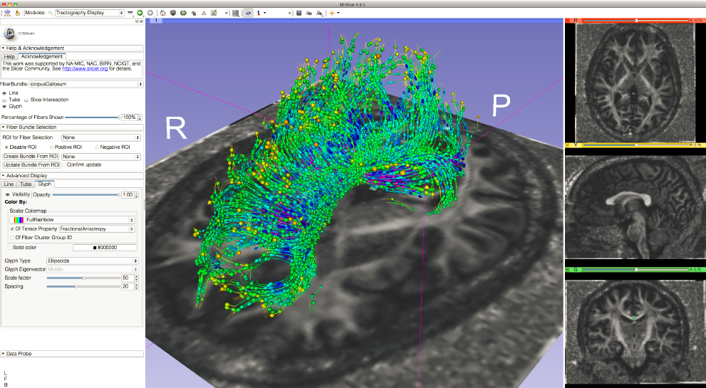
Module type: C++ loadable
Written in C++
Full Slicer API is accessible
Useful for implementing complex, performance-critical, interactive components, application infrastructure (e.g., reusable low-level GUI widgets)
Image courtesy: Sonia Pujol

Slide 5
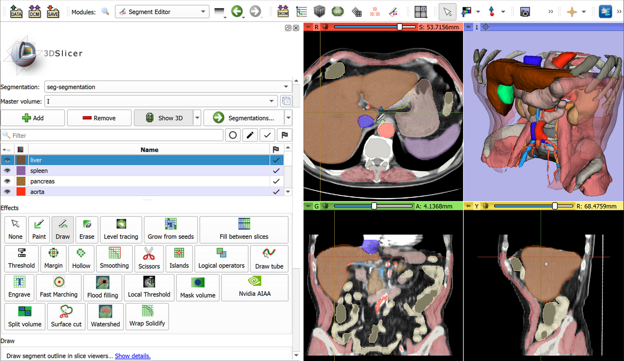
Modules type: Scripted loadable
Written in Python
Full Slicer API is accessible
Simplest way to extend/customize Slicer

Slide 6
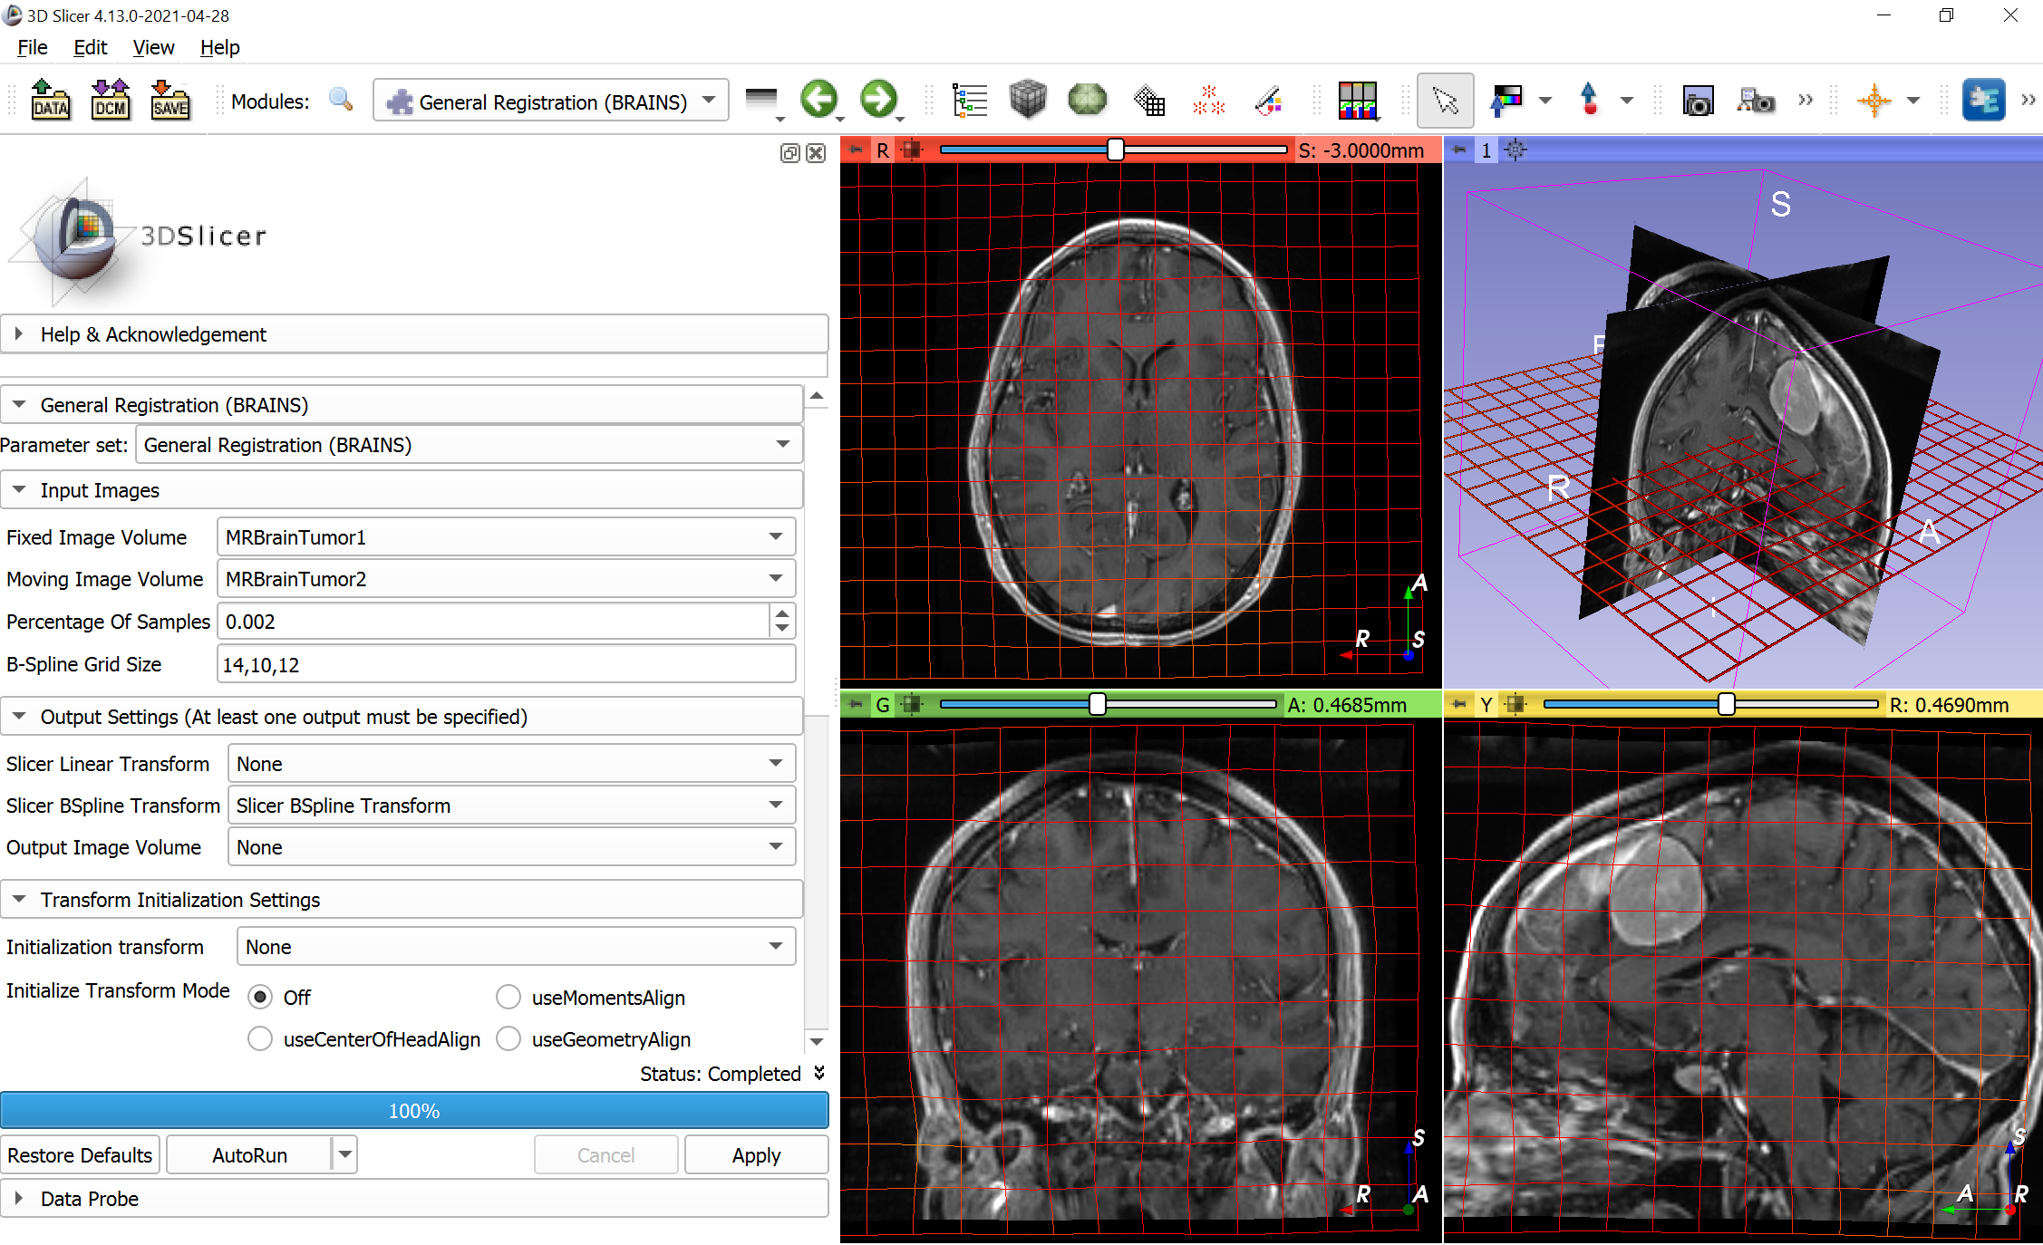
Module type: CLI
CLI = Command-line interface
Slicer can run any command-line application from the GUI
Can be implemented in any language (C++, Python, …)
Inputs and outputs specified in XML file, GUI is generated automatically
Good for implementing computational algorithms

Slide 7
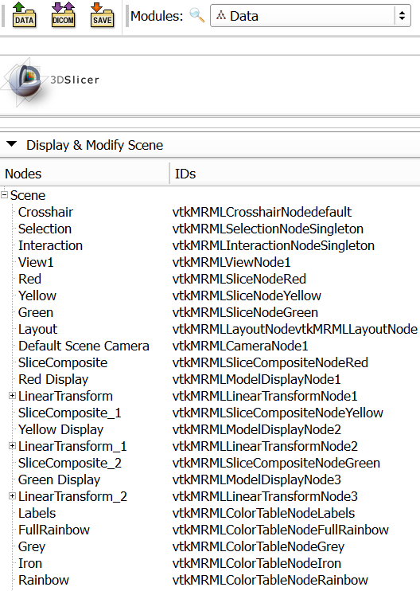
Slicer data model
MRML scene: shared storage of all data objects (MRML: Medical Reality Markup Language)
List of MRML nodes, each identified by a unique string ID
References, observations between nodes
Modules communicate through reading/writing MRML nodes
Modules do not need to know about each other!
Notes:
Questions to attendees:
Who has Linux / C++ / python / Slicer / VTK / ITK / Qt experience?

Slide 8
MRML node
Responsibilities:
Store data
Serialization to/from XML for file storage
No display or processing methods
Basic types:
Data node
Display node: visualization options for data node content; multiple display nodes allowed
Storage node: what format, file name to use for persistent storage of the data node content
Notes:
Questions to attendees:
Who has Linux / C++ / python / Slicer / VTK / ITK / Qt experience?

Slide 9
Scripted module implementation
Module
(MyFirst)
Widget
(MyFirstWidget)
Logic
(MyFirstLogic)
Notes:
Questions to attendees:
Who has Linux / C++ / python / Slicer / VTK / ITK / Qt experience?

Slide 10
Module class
Required. Only one global instance exists:
module = slicer.util.getModule('Volumes')
Stores module name, description, icon, etc.
Creates and holds a reference to logic and widget:
widget = slicer.util.getModuleWidget('Volumes')
logic = slicer.util.getModuleLogic('Volumes')
In scripted loadable modules: getModuleWidget() requires the widget to have a logic member. This is the case for module with passive logic.
Widget and logic has not much use for CLI modules. Use them via MRML (edit CLI parameter node) and slicer.cli.runSync().
Notes:
Questions to attendees:
Who has Linux / C++ / python / Slicer / VTK / ITK / Qt experience?

Slide 11
Scripted module implementation
Module
Create
Create
Widget
Logic
Logic
Create (only for scripted)
Scripted module logic is not created automatically (to facilitate dynamic reloading of the module without restarting the application). The logic has to be instantiated manually:
Option A: Passive logic. Create logic object in the Widget class. This is the simplest and most commonly used (used in the scripted module template). If other modules need to access the logic, they may instantiate the other module’s logic (see example).
Option B: Active logic. Create logic object on startupCompleted() signal and store it in the module class. For example, this is the case when the logic observes the scene and reacts to changes, modifies nodes automatically. Only one such logic is allowed per application, because multiple logics could interfere with each other.
Notes:
Questions to attendees:
Who has Linux / C++ / python / Slicer / VTK / ITK / Qt experience?

Slide 12
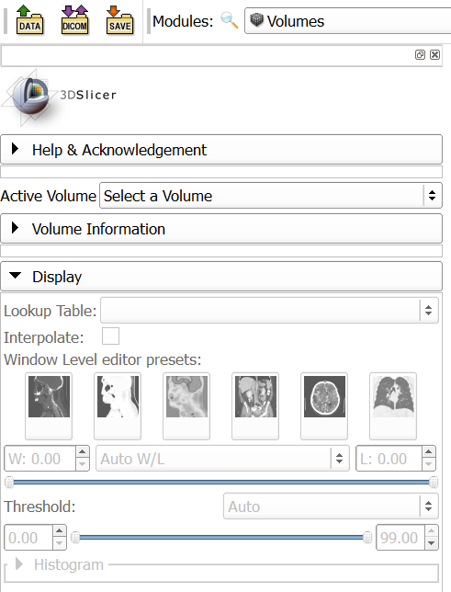
Widget class
Needed if the module has a user interface
Typically only one global instance exists
Defines the module’s user interface
Keeps user interface and nodes in sync (observes MRML nodes to get change notifications)
Launches processing methods implemented in the logic class
Notes:
Questions to attendees:
Who has Linux / C++ / python / Slicer / VTK / ITK / Qt experience?

Slide 13
Widget class
Include a parameter node selector at the top (or use a singleton parameter node)
If a parameter node is selected then add an observer to its modified events; if modified then call widget’s updateGUIFromParameterNode() method
If the user changes the GUI then update MRML node by calling methods that update values in the parameter node. A shared updateParameterNodeFromGUI() method may be used, too, which is called on any GUI user interaction.
Notes:
Questions to attendees:
Who has Linux / C++ / python / Slicer / VTK / ITK / Qt experience?

Slide 14
Scripted module implementation
Module
Create
Create
Widget
Use
Logic
Notify
Observe
Modify
MRML node
Notes:
Questions to attendees:
Who has Linux / C++ / python / Slicer / VTK / ITK / Qt experience?

Slide 15
Logic class
Needed if the module does any processing (always)
The module must be usable from another module, just by calling logic methods
Must not rely on the Widget class: the module must be usable without even having a GUI
Logic may be instantiated many times (to access utility functions inside)
Logic may observe nodes (active logic): only if real-time background processing is needed (e.g., we observe some input nodes and update other nodes if input nodes are changed)
Notes:
Questions to attendees:
Who has Linux / C++ / python / Slicer / VTK / ITK / Qt experience?

Slide 16
Scripted module implementation
Module
Create
Create
Widget
Use
Logic
X
Notify
Notify
Observe
Modify
MRML node
Modify
Notes:
Questions to attendees:
Who has Linux / C++ / python / Slicer / VTK / ITK / Qt experience?
Green area: does not depend on Qt, does not need GUI – can be used for batch processing.

Slide 17
Common mistakes 1
Module
Create
Create
Widget
Logic
Notify
Observe
Modify
MRML node
Everything is implemented in the widget, therefore the module is not usable from another module or with a custom GUI!
Notes:
Questions to attendees:
Who has Linux / C++ / python / Slicer / VTK / ITK / Qt experience?

Slide 18
Common mistakes 2
Module
Create
Create
Widget
Use
Logic
Problem: changes made to the MRML node are not reflected in the GUI!
Modify
MRML node
Modify
Notes:
Questions to attendees:
Who has Linux / C++ / python / Slicer / VTK / ITK / Qt experience?

Slide 19
Common mistakes 3
Module
Create
Create
Widget
Use
Logic
No parameter node is used. When the scene is saved and reloaded all the settings in the module user interface are lost!
Notes:
Questions to attendees:
Who has Linux / C++ / python / Slicer / VTK / ITK / Qt experience?

Slide 20
How module A can use module B?
X
X
Method call
Module A
Module B
Create
Create
Create
Create
Widget A
Use
Logic A
Method call
Logic B
Use
Widget B
Notify
Modify
Notify
Notify
Observe
Observe
Observe
Modify
MRML nodes
Modify
Module logic may modify any MRML nodes – most common form of communication
Module logic class may use another module’s logic class
Module class may use another module class, but this is rarely needed (e.g., to access features that require Qt or other GUI classes)
Notes:
Questions to attendees:
Who has Linux / C++ / python / Slicer / VTK / ITK / Qt experience?

Slide 21
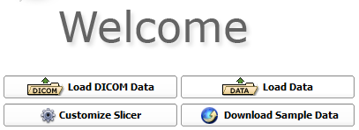

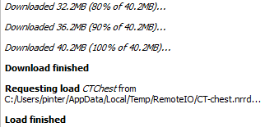
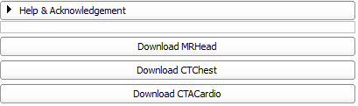
Launch Slicer and load data
Notes:
Open new terminal tab: Ctrl+Shift+T
Switching between tabs: Alt+[tab#]

Slide 22
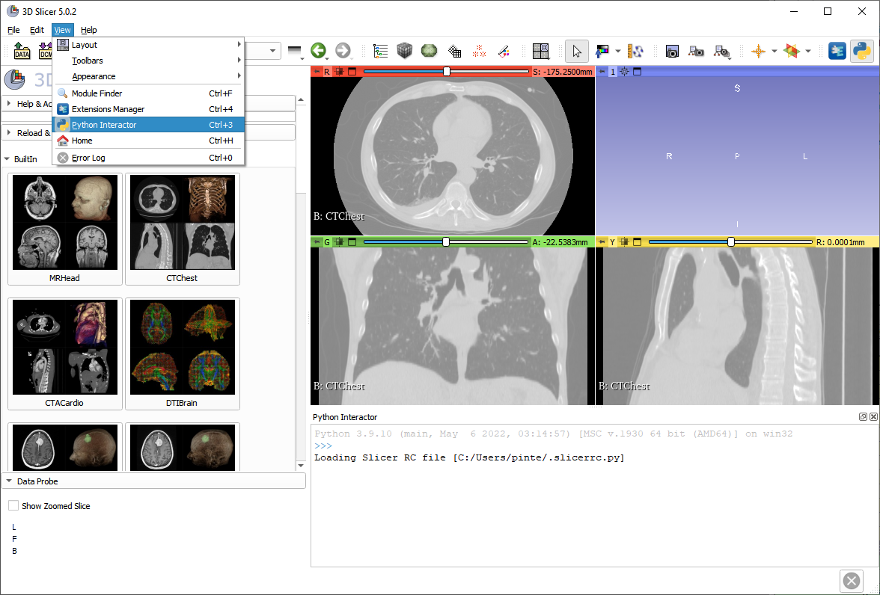
Introducing the python console

Slide 23
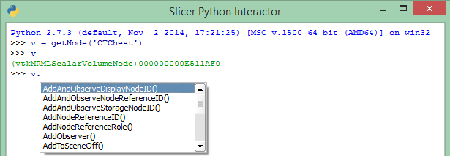
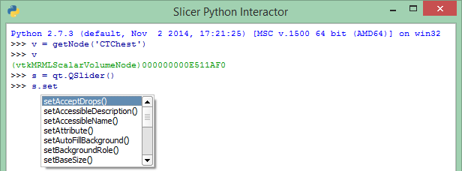
Auto-completion feature
Essential tool that provides API information
Press TAB to bring up auto-complete window to
Explore available functions of a certain object
Save typing

Slide 24
Accessing the MRML scene and nodes
Using utility functions – in slicer.util
v = getNode('CTChest')
OR
v = getNode('CT*')
getNode: somewhat ambiguous, recommended for testing & debugging only
Accessing MRML scene directly
v=slicer.mrmlScene.GetFirstNodeByName('CTChest')
OR
v=slicer.mrmlScene.GetFirstNodeByClass('vtkMRMLScalarVolumeNode')
Notes:
Press tab to get suggestions
Verify object by giving its name;

Slide 25
Information about variables
Get variable type and pointer: enter the variable name
v
(vtkMRMLScalarVolumeNode)0000008FF76243B8
Note: It’s always good to check the variable after you create it
Show node content: all members and attributes inheritance tree
print(v)
Show node API: description of all methods
help(v)
Notes:
Press tab to get suggestions
Verify object by giving its name;

Slide 26
Manipulating Volumes
Setting window/level values programmatically
vd = v.GetDisplayNode()
vd.SetAutoWindowLevel(0)
vd.SetWindowLevel(350,40)
What methods/parameters are available:
help(vd)
OR
vd
(vtkCommonCorePython.vtkMRMLScalarVolumeDisplayNode)0000021AD5436588
http://www.slicer.org/doc/html/classes.html
Notes:
Press tab to get suggestions
Verify object by giving its name
Mention similar VTK and ITK references

Slide 27
Manipulating Volumes
Accessing, changing voxels – using numpy
Get voxel value at (100,200,30) position
va = slicer.util.arrayFromVolume(v)
va[100,200,30]
-986
Thresholding
vaOriginal=va.copy()
va[va<200] = -3000
va[va>200] = 2000
slicer.util.arrayFromVolumeModified(v)
Process with arbitrary function
va[:] = vaOriginal[:]*2.5-500; v.Modified()
<= get voxels as a numpy array
<= voxel value
<= save the original voxel values
<= indicate to Slicer that updates are completed
Notes:
Press tab to get suggestions
Verify object by giving its name
Mention similar VTK and ITK references

Slide 28
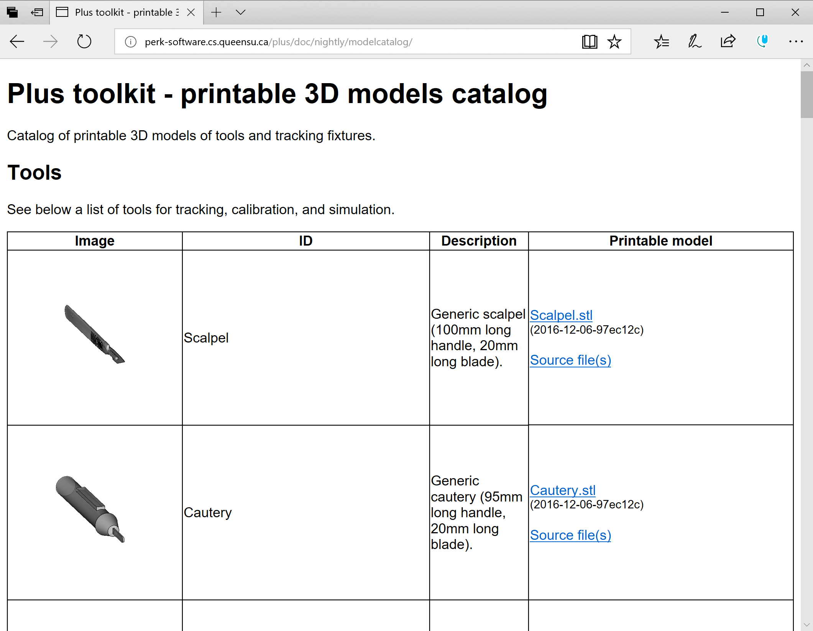
Load model
http://perk-software.cs.queensu.ca/plus/doc/nightly/modelcatalog/
Notes:
Open new terminal tab: Ctrl+Shift+T
Switching between tabs: Alt+[tab#]

Slide 29
Manipulating Models
Setting model color programmatically
c = getNode('Cautery')
cd = c.GetDisplayNode()
cd.SetColor(1,0,0)
Change model to a sphere
s = vtk.vtkSphereSource()
s.SetRadius(30)
s.SetCenter(30,40,60)
s.Update()
c.SetAndObservePolyData(s.GetOutput())
Notes:
Press tab to get suggestions
Verify object by giving its name
Mention similar VTK and ITK references

Slide 30
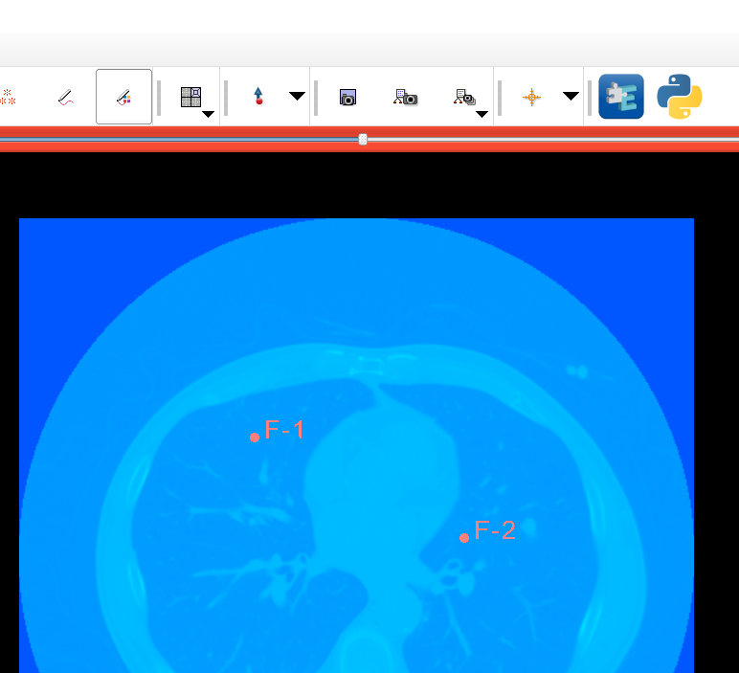
Manipulating Markups
Create 2 markup points (this creates a markup fiducial list node named ‘F’)
Get markup position
f = getNode('F')
f.GetNthControlPointPosition(0)
(58.93727622783058, 45.58082600473318, -170.2500000000001)
1, 3
2
4
Notes:
Press tab to get suggestions
Verify object by giving its name
Mention similar VTK and ITK references

Slide 31
Observing MRML objects
def printPos(caller=None, event=None):
f = getNode('F')
pos = f.GetNthControlPointPosition(0)
print(pos)
printPos()
[58.93727622783058, 45.58082600473318, -170.2500000000001]
obsTag=f.AddObserver(slicer.vtkMRMLMarkupsNode.PointModifiedEvent, printPos)
[20.267904116373643, 4.977985287703447, -170.2500000000001]
[21.92516292115039, 1.6634676781499849, -170.2500000000001]
[22.477582522742637, 1.1110480765577364, -170.2500000000001]
[24.687260929111574, 0.5586284749655164, -170.2500000000001]
[26.34451973388832, 0.00620887337326792, -170.2500000000001]
f.RemoveObserver(obsTag)
These lines start with 2 spaces!
=> Drag-and-drop first fiducial
Notes:
Press tab to get suggestions
Verify object by giving its name
Mention similar VTK and ITK references

Slide 32
Share your tools
In the spirit of the open-source paradigm, it is encouraged to share your tools
The shared extensions
appear in the Extension Manager
are nightly tested on the Slicer Factory platforms
How to share?
Fork ExtensionIndex from GitHub and upload your extension description (.s4ext) file https://github.com/Slicer/ExtensionsIndex
Ask the core team to integrate (send a “pull request”)

Slide 33
Part 2
Use python console in Slicer
Simple scripted module example

Slide 34
Python in general
Blocks defined by indentation: 2 spaces
Case sensitive
Comments
# This whole row is a comment
"""This is a potentially multi-line comment"""
Blocks defined by indentation
An object refers to itself as self (in C++: this)
Namespaces: slicer, ctk, vtk, qt
Blocks … indentation … spaces!

Slide 35
Text editor / IDE
Using a proper text editor is essential
Replace all, Easy comment/uncomment, indent, …
Syntax highlighting
Keyboard shortcuts
Recommended: Cross-platform: Visual Studio Code, Sublime Text
Windows-only: Notepad++, Mac-only: Xcode
Integrated development environment is even better:
Text editor + debugger, code browser, …
Recommended: Visual Studio Code, PyCharm

Slide 36
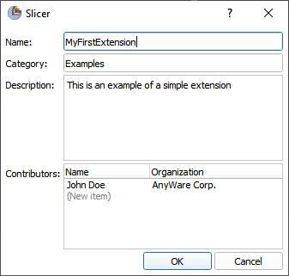
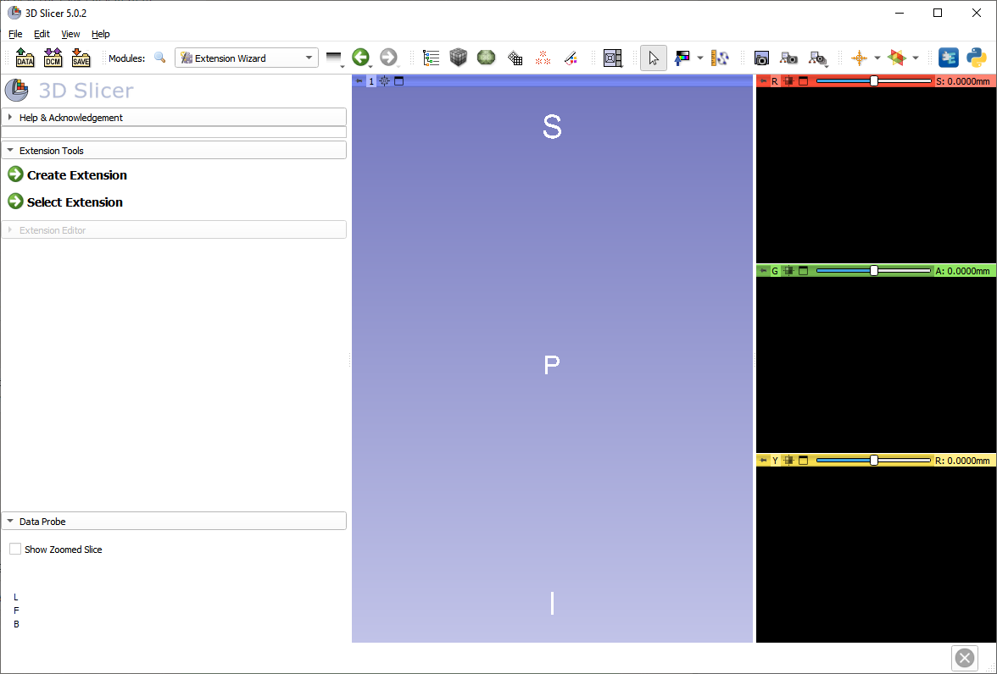
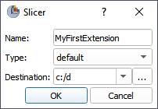
Create extension
Enter name: MyFirstExtension
Choose destination: In your Git repo!
Notes:
Questions to attendees:
Who has Linux / C++ / python / Slicer / VTK / ITK / Qt experience?

Slide 37
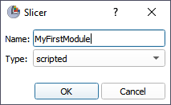
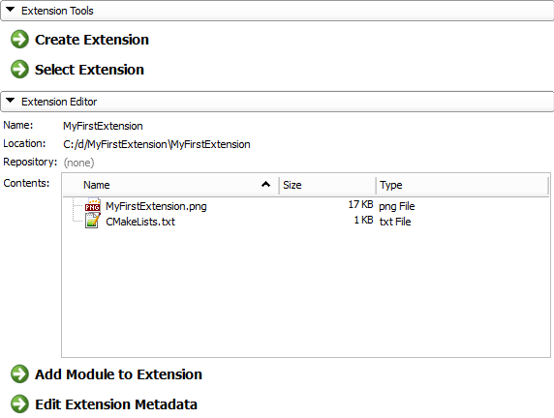
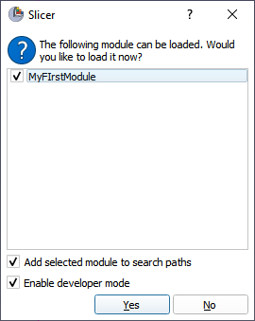
Create module

Slide 38
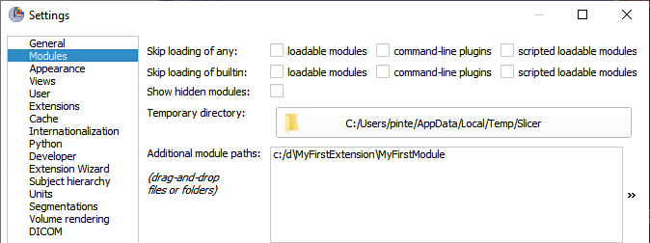
Module paths
To make Slicer load a module, add its folder (where the .py file is located) to “Additional module paths” in Application Settings
You can drag&drop the .py file or folder
Checking the “Add selected module to search paths” checkbox added the listed modules to this path list already

Slide 39
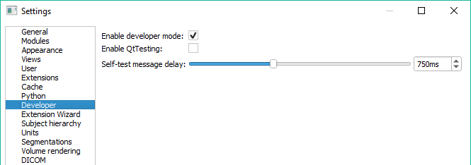
Developer mode
Enable features useful for development
Allow dynamic reload of source code etc.
In Application Settings
Restart Slicer

Slide 40
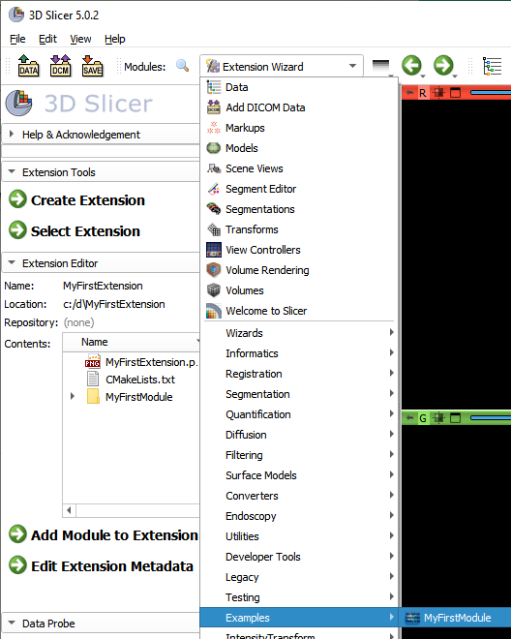
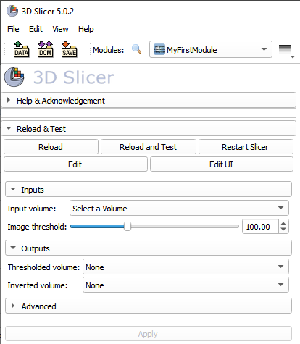
Find the new module in Slicer

Slide 41
Commit your changes regularly
Commit your changes
New files need to be added explicitly
Commit message should look like this: "Re #7: Description of why I did what I did" (do not describe what you did, it's obvious from the diff)
When you think you're done "Test #7: Description of why I did what I did"
When everybody agrees you're done "Fixed #7: Description of why I did what I did"
Pull (Fetch+Rebase) before each commit!

Slide 42
Write our scripted module #1
Rename the module in the .py file
Note: the _() function is used for internationalization, i.e., to be able to translate the user interface of modules to various languages. Slicer’s translation infrastructure collects all the strings used as arguments in _() functions and offer it for translation. You can learn more about translation of 3D Slicer in the LanguagePacks extension’s documentation.
def __init__(self, parent):
ScriptedLoadableModule.__init__(self, parent)
self.parent.title = _("Center of Mass")

Slide 43
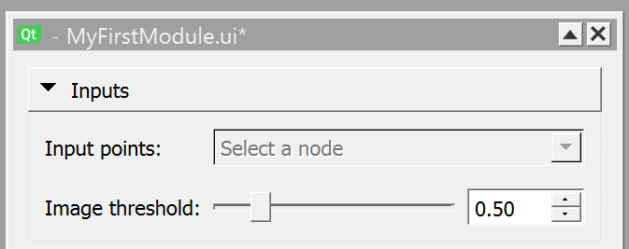
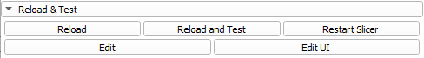
Write our scripted module #2
Customize widgets in Qt Designer: change the “Input volume” label to “Input points”, because our module will use a point list as input
Double-click “Input Volume” label and enter “Input points:”
Don’t forget to save the .ui file in Qt Designer
Click “Reload” button in 3D Slicer, the module GUI will show “Input points” in the label

Slide 44
Write our scripted module #3
Change the source code so that the user can select point list markups node instead of an image volume as input. Class name corresponding to a point list markup is “vtkMRMLMarkupsFiducialNode”.
1. Near line 15: import vtkMRMLMarkupsFiducialNode
from slicer import vtkMRMLScalarVolumeNode
from slicer import vtkMRMLMarkupsFiducialNode
2. Near line 114: replace vtkMRMLScalarVolumeNode by vtkMRMLMarkupsFiducialNode
MyFirstModuleParameterNode
…
inputVolume: vtkMRMLScalarVolumeNode vtkMRMLMarkupsFiducialNode
Add this line
Remove
Add

Slide 45
Write our scripted module #4
Look for class MyFirstModuleLogic
Insert this code in the logic class (for example, above the process function)
Remember to save the file changes
Click the Reload button in Slicer and check that there are no errors printed into the Python console.
def getCenterOfMass(self, markupsNode):
centerOfMass = [0,0,0]
import numpy as np
sumPos = np.zeros(3)
for i in range(markupsNode.GetNumberOfControlPoints()):
pos = markupsNode.GetNthControlPointPosition(i)
sumPos += pos
centerOfMass = sumPos / markupsNode.GetNumberOfControlPoints()
logging.info(f'Center of mass for {markupsNode.GetName()}: {centerOfMass}')
return centerOfMass
Notes:
Take extra care of the indentation! 2 spaces before the whole thing and 2 spaces before each sub-block

Slide 46
Write our scripted module #5
Change the process function to use the center of mass computation function and store the result in the logic object:
def process(self, inputMarkups, outputVolume, imageThreshold, enableScreenshots=0):
"""
Compute center of mass of input markup points
"""
self.centerOfMass = self.getCenterOfMass(inputMarkups)
return True

Slide 47
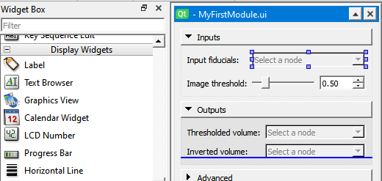
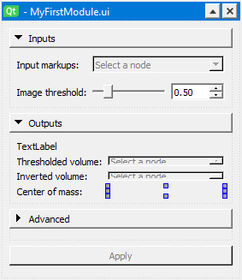
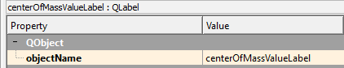
Write our scripted module #6
Add a new label to display the computed position.
Drag&drop a “Label” widget in the module widget at the bottom of the outputs section.
Double-click the label to edit the text and enter “Center of mass:”
Drag&drop a second one in the right column, make it empty
Rename the object to centerOfMassValueLabel
The end result should look like this:

Slide 48
Write our scripted module #7
Update the widget class to show the result after computation.
Set the computation result in the “centerOfMassValueLabel” in the “MyFirstModuleWidget” class:
Update the code that checks if all the inputs are specified. We only need one input node
Pay attention to correct indentation!
def onApplyButton(self) -> None:
"""Run processing when user clicks "Apply" button."""
with slicer.util.tryWithErrorDisplay(_("Failed to compute results."), waitCursor=True):
# Compute output
self.logic.process(self.ui.inputSelector.currentNode(),
self.ui.outputSelector.currentNode(),
self.ui.imageThresholdSliderWidget.value,
self.ui.invertOutputCheckBox.checked)
self.ui.centerOfMassValueLabel.text = str(self.logic.centerOfMass)
def _checkCanApply(self, caller=None, event=None) -> None:
if self._parameterNode and self._parameterNode.inputVolume:
self.ui.applyButton.toolTip = _("Compute center of mass")
self.ui.applyButton.enabled = True
else:
self.ui.applyButton.toolTip = _("Select input point list")
self.ui.applyButton.enabled = False

Slide 49
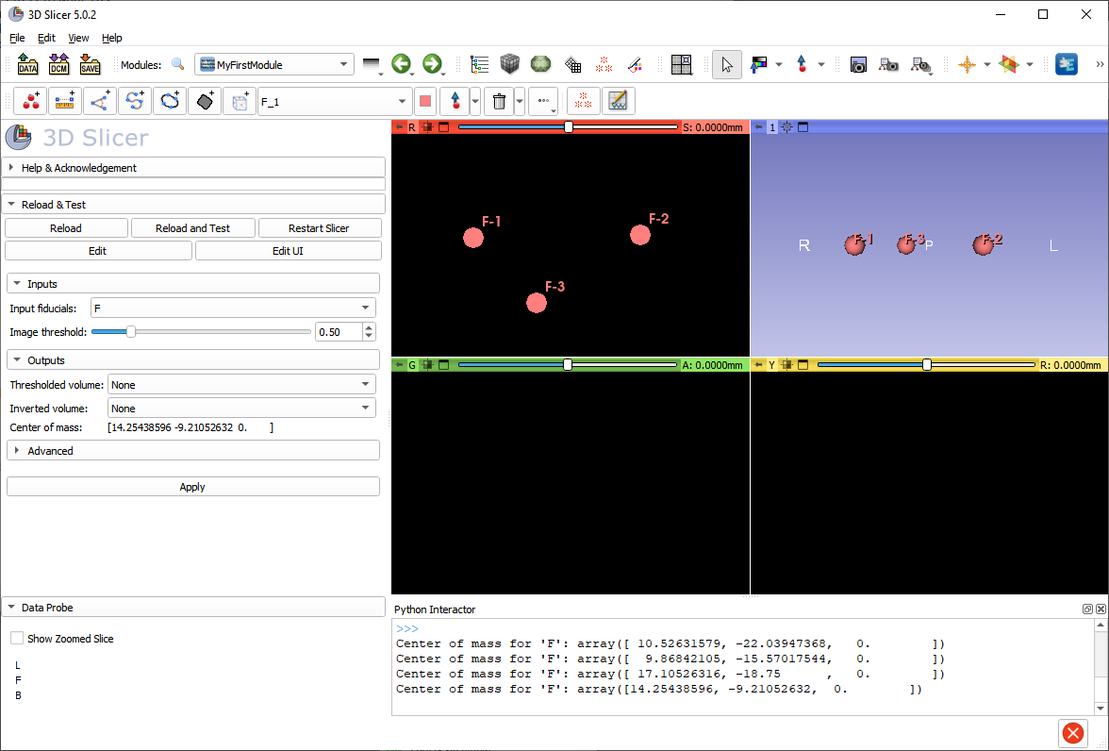
Try our scripted module
Go to our module in Examples / Center of Mass
Add a few markups
Press Apply
1. Display displacement center of mass position → works!
2. Displays nothing → error can be seen in the Python interactor

Slide 50
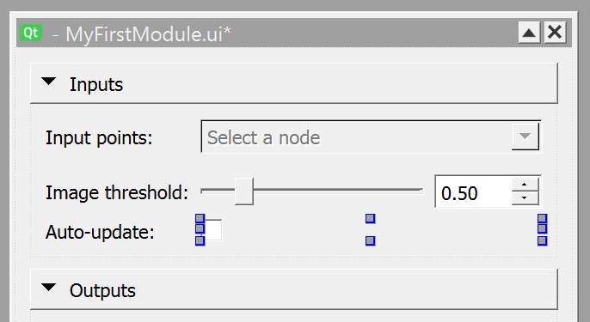
Add auto-update checkbox GUI
Add a new Label
Double-click to rename to “Auto-update:”
Add a checkbox
Double click to remove the text from the checkbox label to follow Slicer user interface conventions
Change “objectName” of the checkbox to: “autoUpdateCheckBox“
Save the .ui file

Slide 51
Add auto-update checkbox widget #1
Implement an “observer” (a method that is called each time a node is modified) that is activated/deactivated with the auto-update checkbox.
1. Add variable that stores the currently observed markup node and the observer’s tag (an identifier that we need for removing the observer) to the __init__ method.
def __init__(self, parent=None) -> None:
"""Called when the user opens the module the first time and the widget is initialized."""
ScriptedLoadableModuleWidget.__init__(self, parent)
VTKObservationMixin.__init__(self) # needed for parameter node observation
self.logic = None
self._parameterNode = None
self._parameterNodeGuiTag = None
self.observedMarkupNode = None
self._markupsObserverTag = None
Add these lines

Slide 52
Add auto-update checkbox widget #2
2. Add a method to the “MyFirstModuleWidget” class that adds/removes an observer to the current markup node:
def onEnableAutoUpdate(self, autoUpdate):
if self._markupsObserverTag:
self.observedMarkupNode.RemoveObserver(self._markupsObserverTag)
self.observedMarkupNode = None
self._markupsObserverTag = None
if autoUpdate and self.ui.inputSelector.currentNode:
self.observedMarkupNode = self.ui.inputSelector.currentNode()
self._markupsObserverTag = self.observedMarkupNode.AddObserver(
slicer.vtkMRMLMarkupsNode.PointModifiedEvent, self.onMarkupsUpdated)
3. Add a callback method to the “MyFirstModuleWidget” class that is called when the observed markup node is changed:
def onMarkupsUpdated(self, caller=None, event=None):
self.onApplyButton()
4. Make the auto-update checkbox enable/disable auto-update by adding a connection in “MyFirstModuleWidget” class “setup” method:
self.ui.autoUpdateCheckBox.connect("toggled(bool)", self.onEnableAutoUpdate)

Slide 53
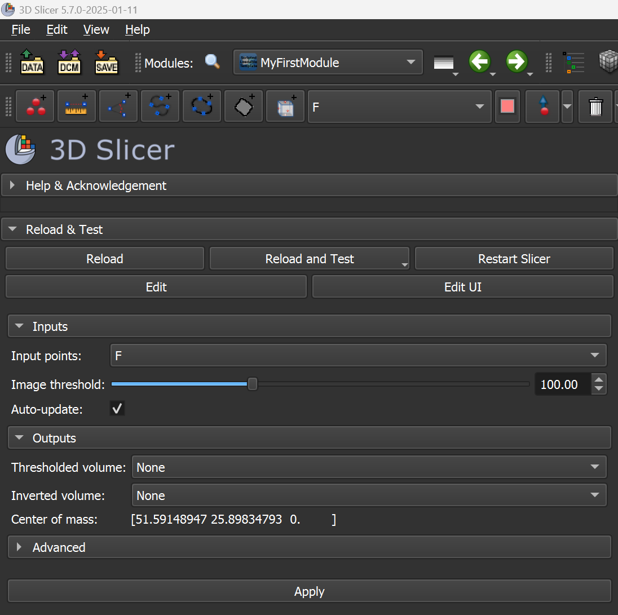
Try auto-update
Reload the module
Check auto-update checkbox
Move markup points, the Center of mass value will update automatically

Slide 54
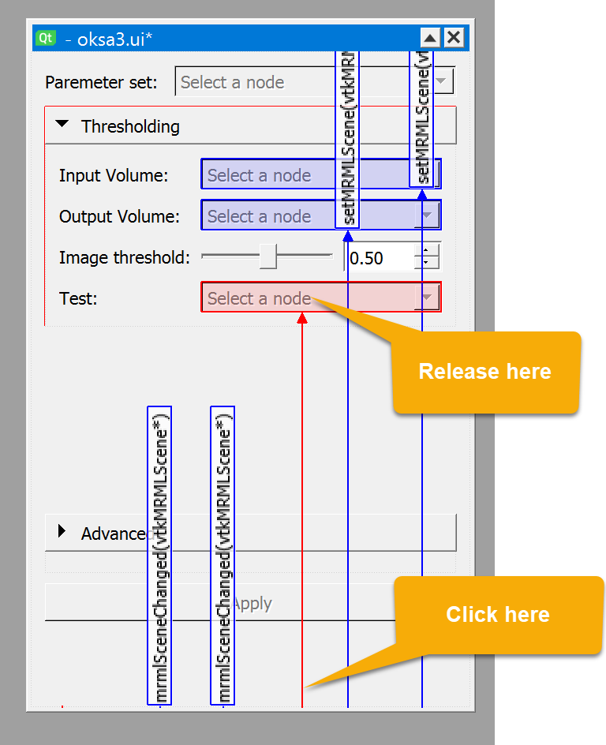
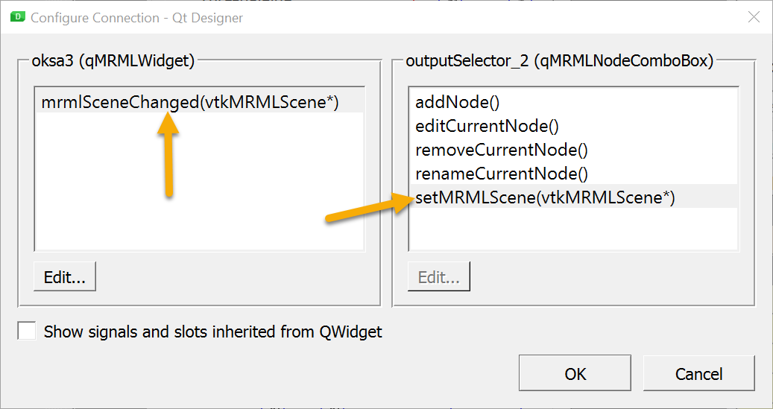
Tip #1: Adding MRML widgets
MRML widgets, such as node selector (qMRMLNodeComboBox) require setting of the MRML scene
Scene can be set in Designer by connecting the mrmlSceneChanged(vtkMRMScene*) signal of the top-level widget to the setMRMLScene(vtkMRMLScene*) slot of the widget
Option A: Use Signal/Slot Editor (by default in the lower-right corner)
Option B: Switch to Edit Signals/Slots mode (menu: Edit -> Edit Signals/Slots or F4 key) and press mouse button in an empty area in the top-level widget, move the mouse over the MRML widget, and release the mouse button; then select the signal and slot

Slide 55
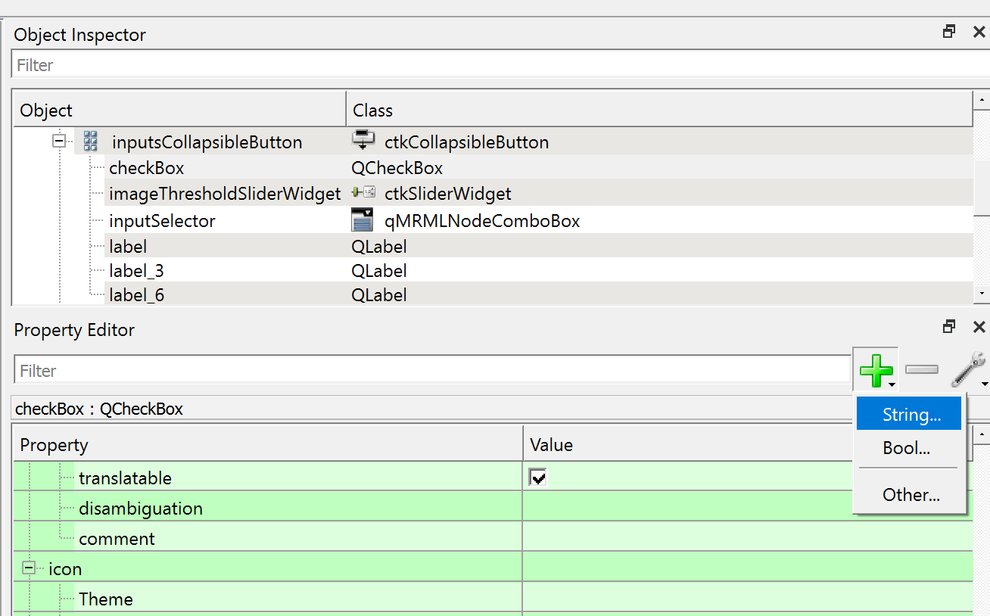
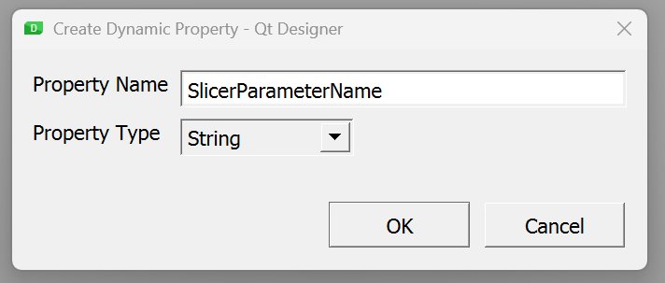
Tip #2: Binding GUI widgets to parameters
“Parameter node wrapper” infrastructure can be used to conveniently synchronize GUI widget (checkbox, slider, line edit, etc.) and a value in the parameter node. Values in the parameter node are saved into the scene and are easily accessible in the widget and logic classes. To bind a widget to a parameter:
1. Add a new “String” property named “SlicerParameterName”

Slide 56
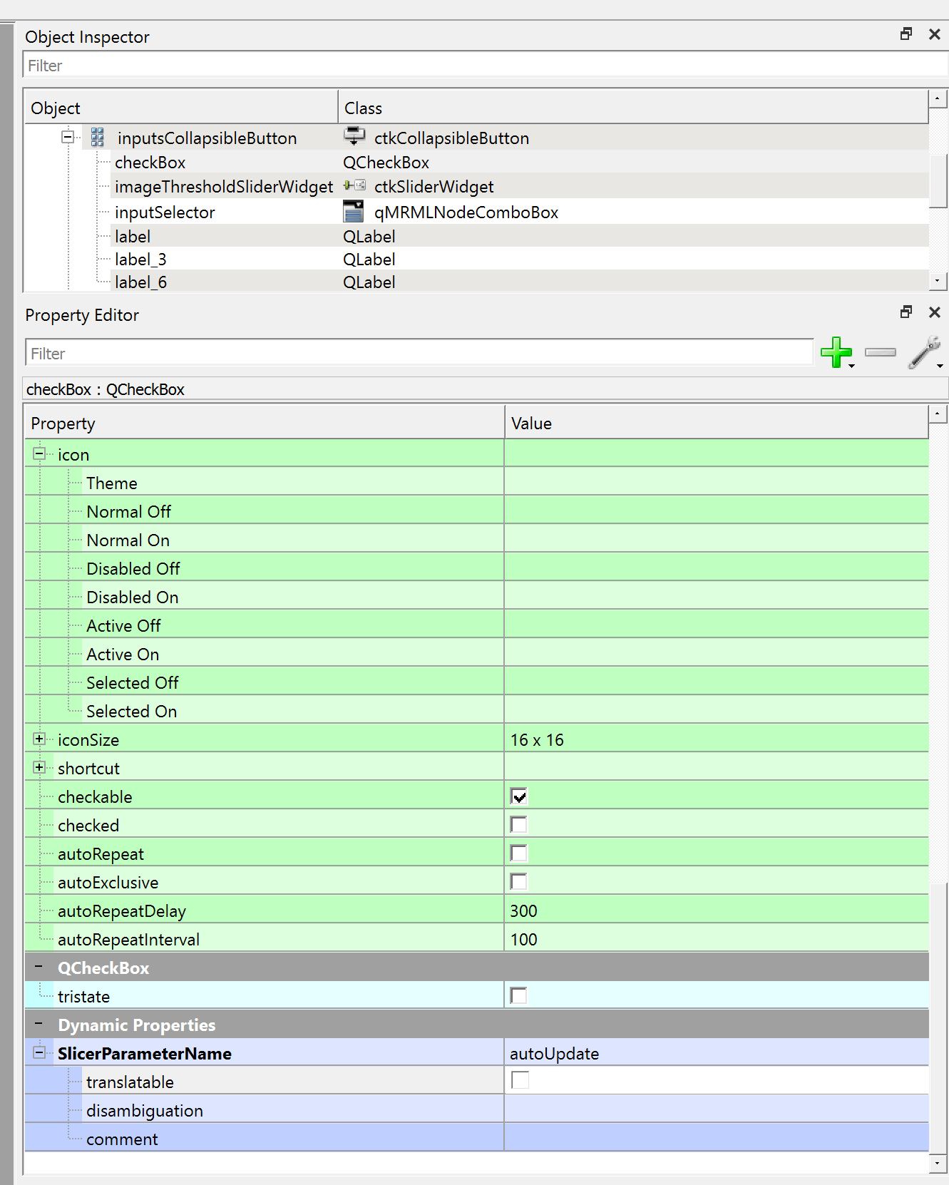
Tip #2: Binding GUI widgets to parameters
2. Disable “translatable” property (this string is the same in all languages, must not be translated)
3. Set the “SlicerParameterName” value to the parameter name used in the .py file:
Note that after this change, when the module is reloaded, the state of the button is now preserved.
@parameterNodeWrapper
class MyFirstModuleParameterNode:
inputVolume: vtkMRMLMarkupsFiducialNode
…
invertThreshold: bool = False
thresholdedVolume: vtkMRMLScalarVolumeNode
invertedVolume: vtkMRMLScalarVolumeNode
autoUpdate: bool = False

Slide 57
Part 3
Write simple scripted module (somewhat) independently

Slide 58
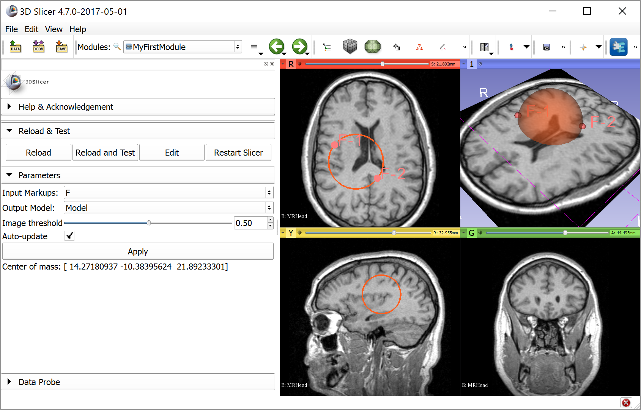
Task description
Goal: Position a sphere-shaped model with two markup points

Slide 59
API documentation
Generic computing and GUI libraries
Toolkit | API documentation
Python | https://docs.python.org/es/3.9/index.html
Numpy | http://docs.scipy.org/doc/numpy/reference
VTK | https://vtk.org/doc/nightly/html
SimpleITK | http://www.itk.org/SimpleITKDoxygen/html/classes.html
Qt | https://doc.qt.io/qt-5.15/classes.html
Slicer-specific libraries
Toolkit | API documentation
Slicer core | C++: http://www.slicer.org/doc/html/classes.html Python: http://mwoehlke-kitware.github.io/Slicer/Base/slicer.html For up-to-date docs, type this into Python console: help(slicer.util)
CTK | http://www.commontk.org/docs/html/classes.html
Notes:
Questions to attendees:
Who has Linux / C++ / python / Slicer / VTK / ITK / Qt experience?

Slide 60
Where to find examples
Slicer core: https://github.com/Slicer/Slicer
Extensions:
Index of extensions (see repository in *.s4ext): https://github.com/Slicer/ExtensionsIndex
SlicerIGT: https://github.com/SlicerIGT/SlicerIGT/
SlicerRT: https://github.com/SlicerRt/SlicerRT
Notes:
Questions to attendees:
Who has Linux / C++ / python / Slicer / VTK / ITK / Qt experience?

Slide 61
Hints
To be able to show a model node, create display node:
outputModel.CreateDefaultDisplayNodes()
To show model intersections with a 2D slice viewer: outputModel.GetDisplayNode().SetSliceIntersectionVisibility(True)
Remember that all the logic is implemented in the run function in the logic class, which is called in the onApplyButton function

Slide 62

Congratulations!
Thanks for attending!

Slide 63
Appendix

Slide 64
Transforms
Slicer world coordinate system: RAS (right-anterior-superior)
Get linear transform from the node to RAS:
nodeToRas = vtk.vtkMatrix4x4()
if node.GetTransformNodeID():
nodeToRasNode = slicer.mrmlScene.GetNodeByID(node.GetTransformNodeID())
nodeToRasNode.GetMatrixTransformToWorld(nodeToRas)
Transform may be non-linear
At least log an error if transform is present but it is ignored
Notes:
Questions to attendees:
Who has Linux / C++ / python / Slicer / VTK / ITK / Qt experience?

Slide 65
Node references
Always use this whenever a node relies on data stored in other nodes
Specified by role name, referenced node ID, index (multiple references with the same role is allowed)
Saved/restored with the scene
Not trivial: When importing a scene and a node ID is already found in the current scene, the imported node ID is automatically renamed and all references are updated
Scene
ModelNode1
ModelDisplayNode1
ModelDisplayNode2
ModelStorageNode1
VolumeNode1
VolumeDisplayNode1
VolumeStorageNode1
Notes:
Questions to attendees:
Who has Linux / C++ / python / Slicer / VTK / ITK / Qt experience?

Slide 66






Overview of API’s accessible from python
Notes:
Questions to attendees:
Who has Linux / C++ / python / Slicer / VTK / ITK / Qt experience?

